Slide 1
අධ්‍යයන කාර්ය මණ්ඩල සාමාජිකයින් මාර්ගගත (Online)
පරිගණක වැඩසටහන (Web Portal) වෙත පිවිස
2025 තොරතුරු
2026-09-01 දිනට අදාළ වන පරිදි
යාවත්කාලීන කලයුතු ආකාරය

Slide 2

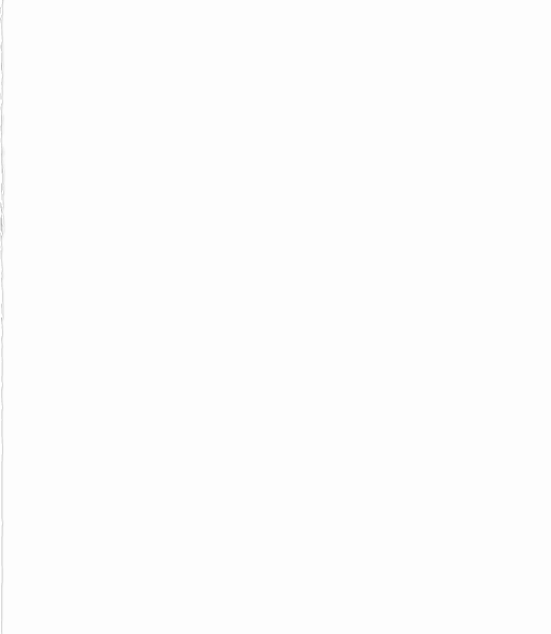

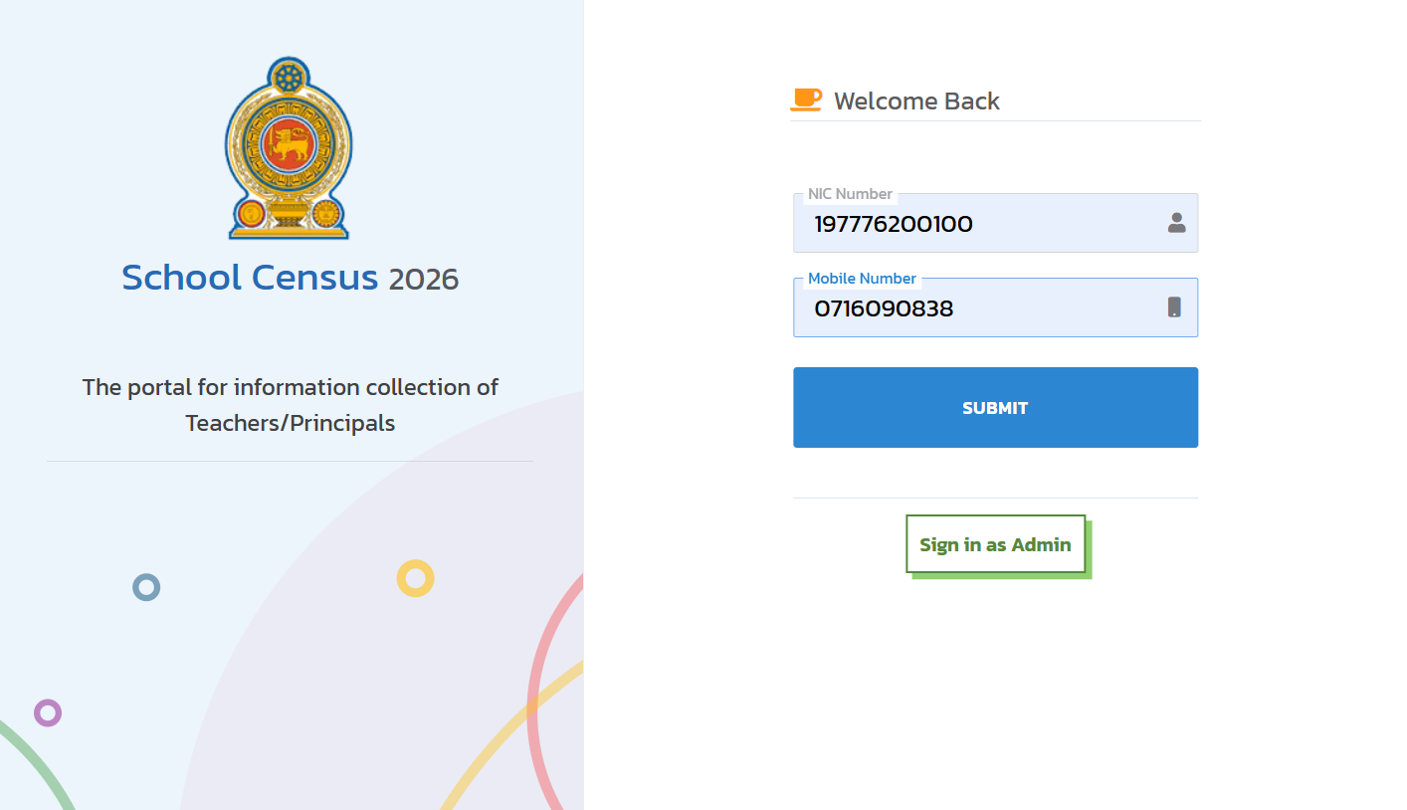
Individual Teacher Login
Step 1: Enter NIC Number & Mobile Number in above Spaces and Click on SUBMIT Button

Slide 3
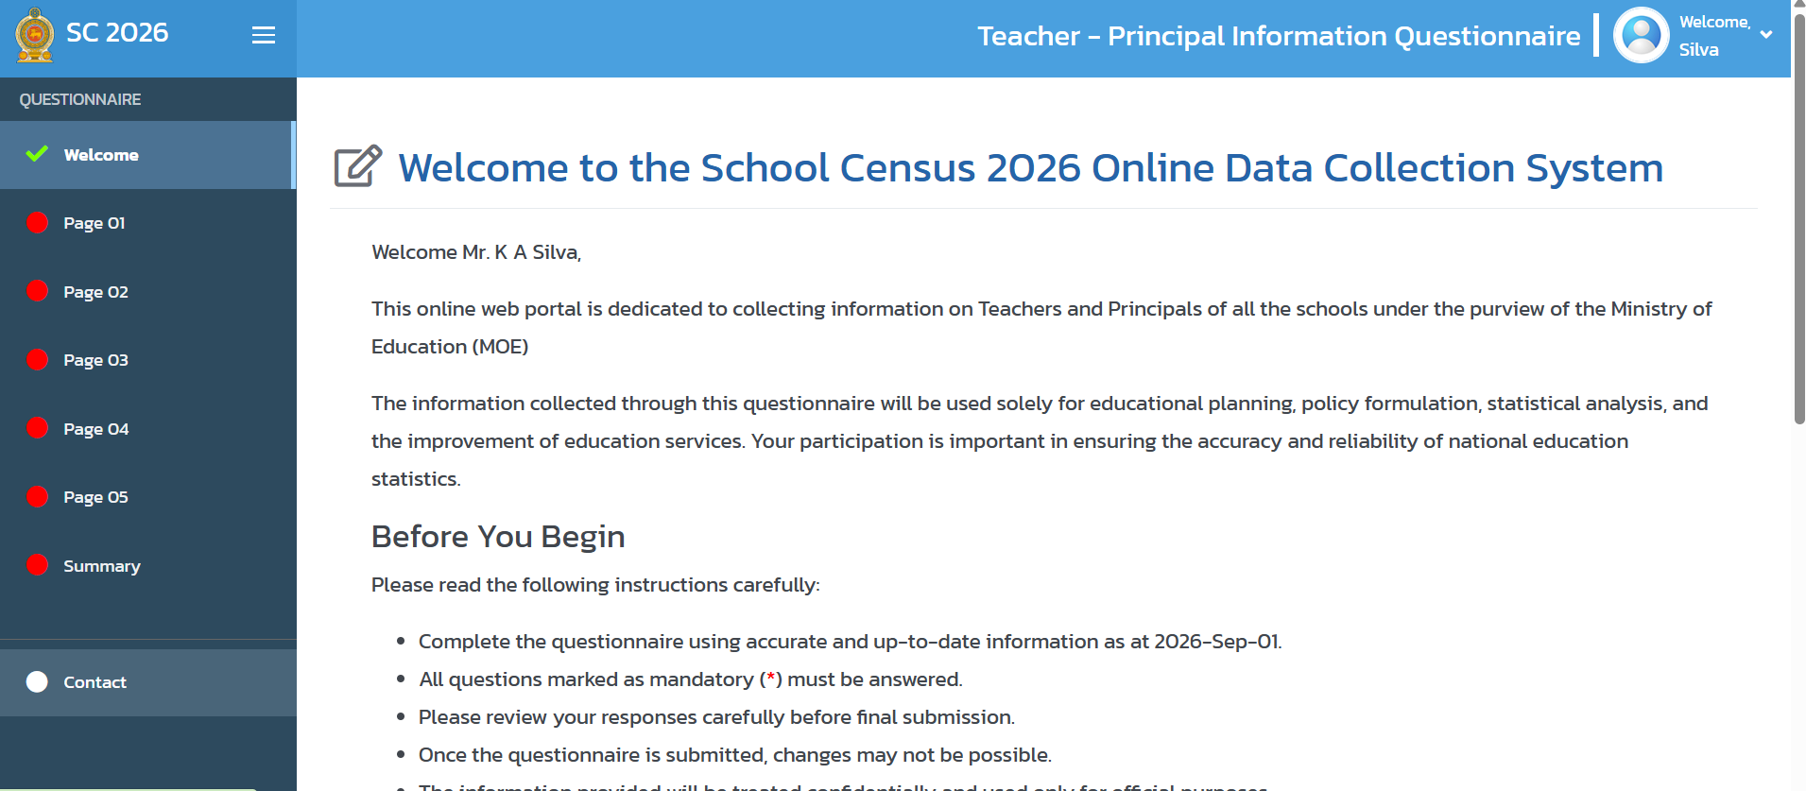
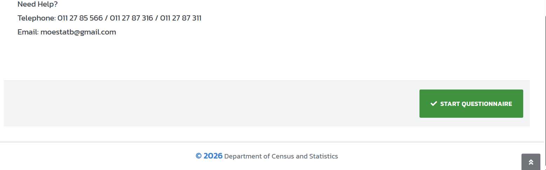
Carefully Read the Instructions
Step 2: Click on START QUESTIONNAIRE Button

Slide 4
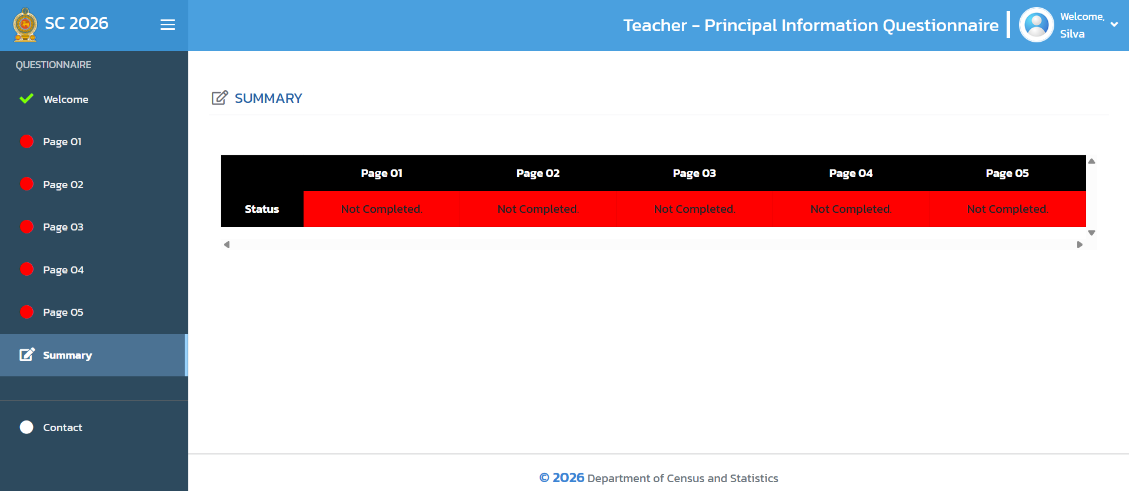
Initial Appearance of the Summary Tab Section

Slide 5
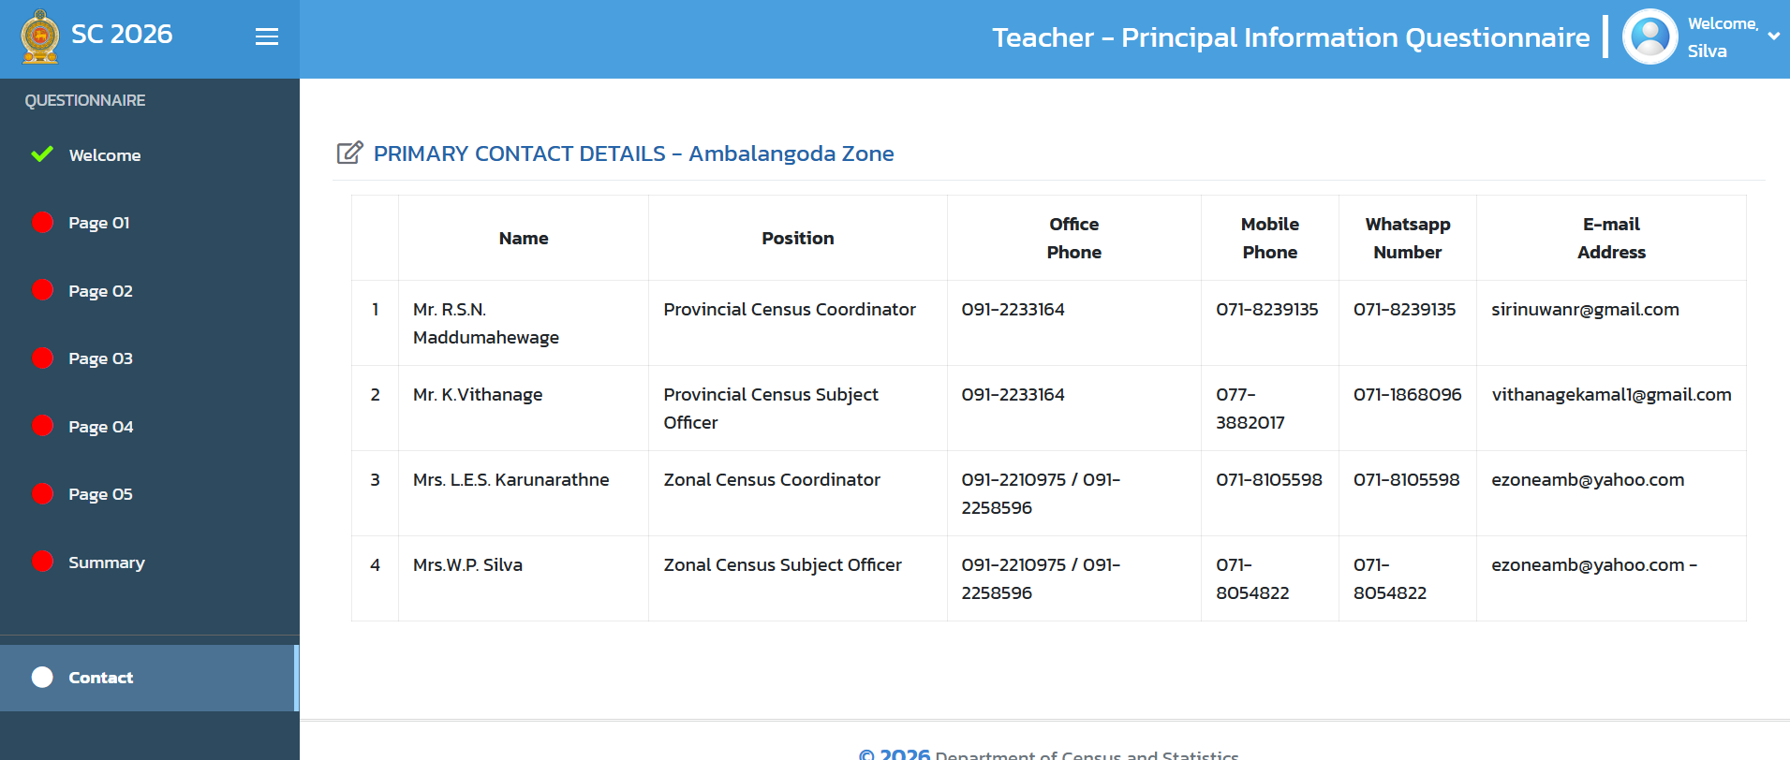
To See the Contact Details of the Provincial and Zonal Census Team Click on Contact Tab

Slide 6
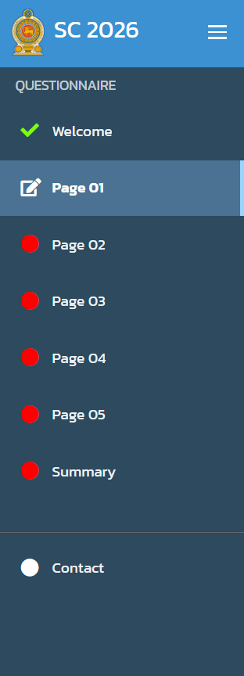
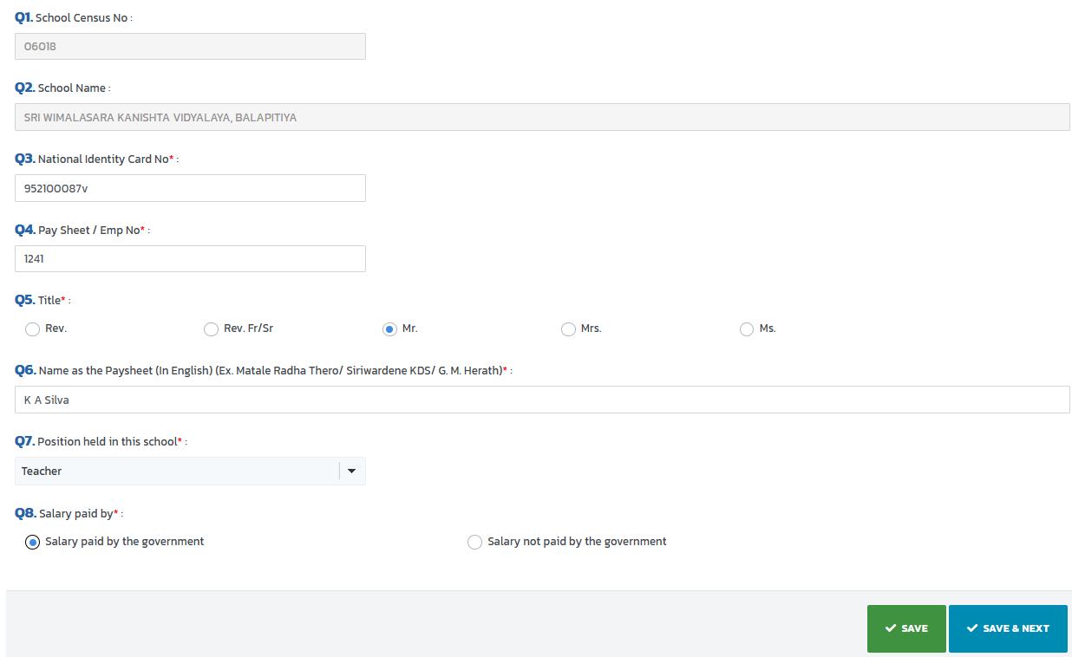

Step 3: Carefully Read All Relevant Questions and Initial Answers and if required any update/ change Please make that change using Drop down lists/ Select relevant combo box
Step 4: First Click on SAVE button when complete the updating of any page, then Click on SAVE & NEXT button to move next page

Slide 7
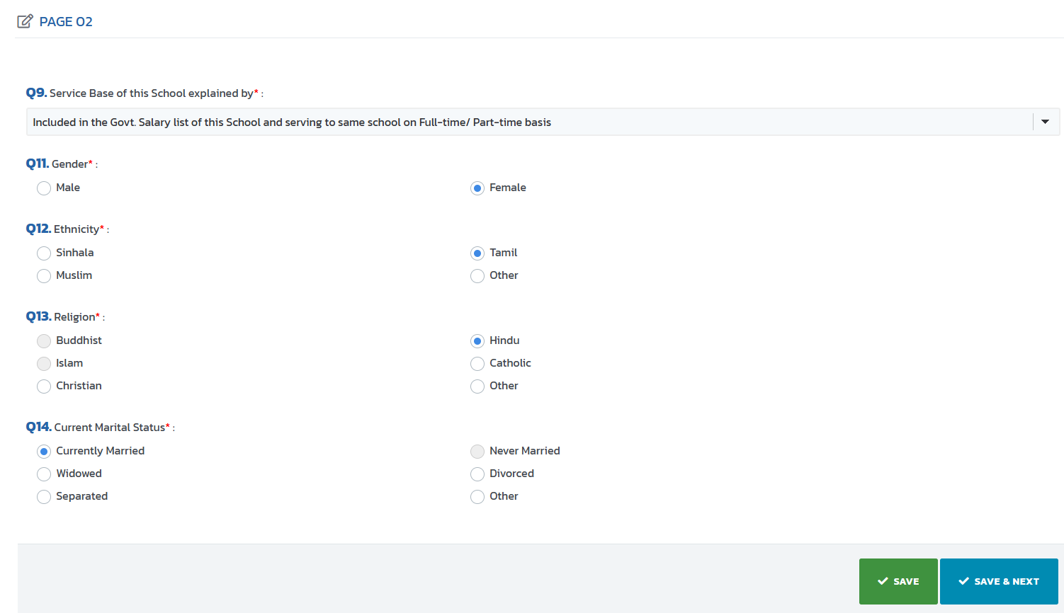
Initial Appearance of Page 2

Slide 8
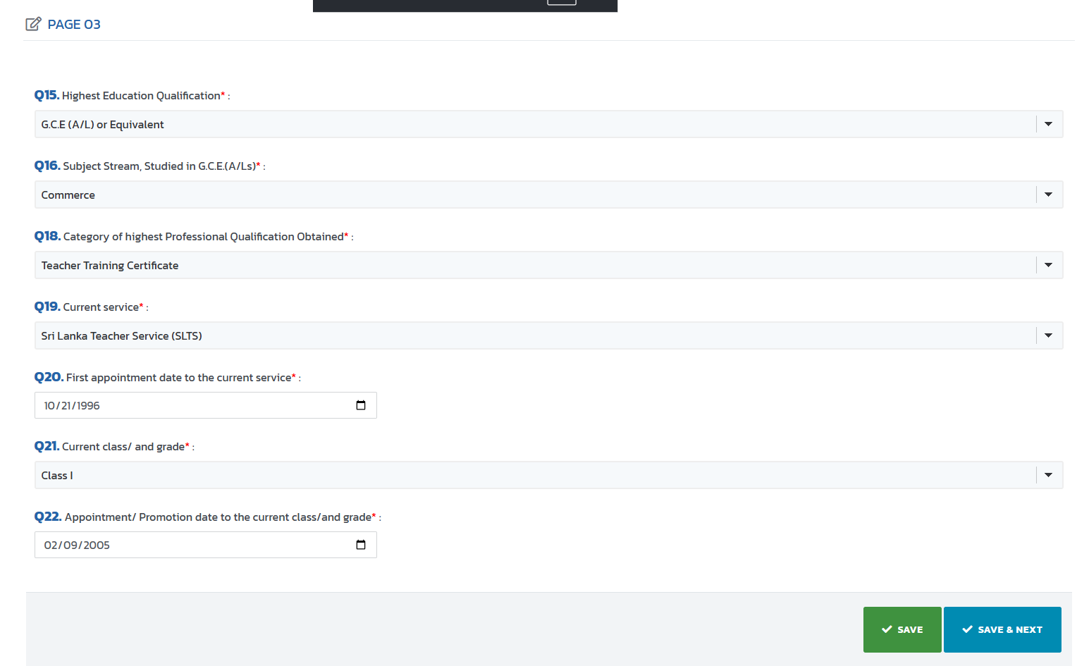
Initial Appearance of Page 3

Slide 9
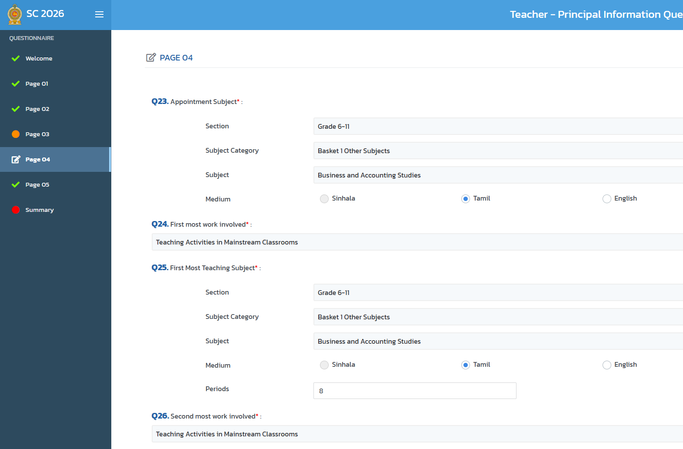
Initial Appearance of Page 4

Slide 10
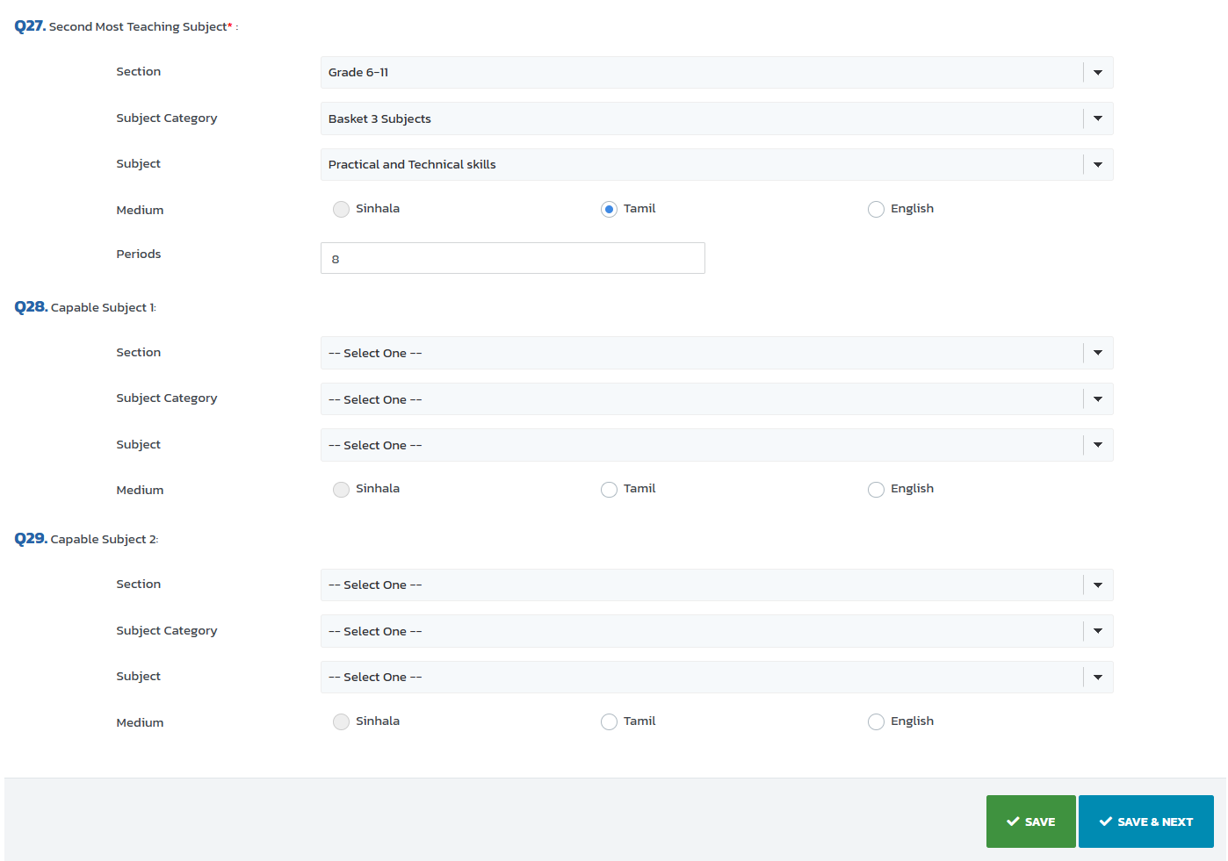
Initial Appearance of Q27, 28 & 29 of Page 4

Slide 11
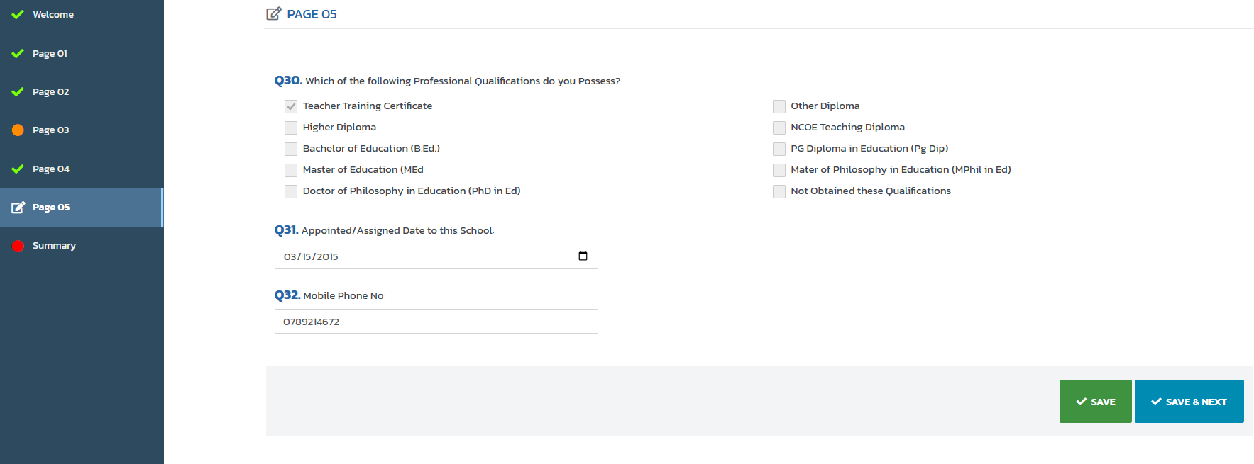
Initial Appearance of Page 5

Slide 12
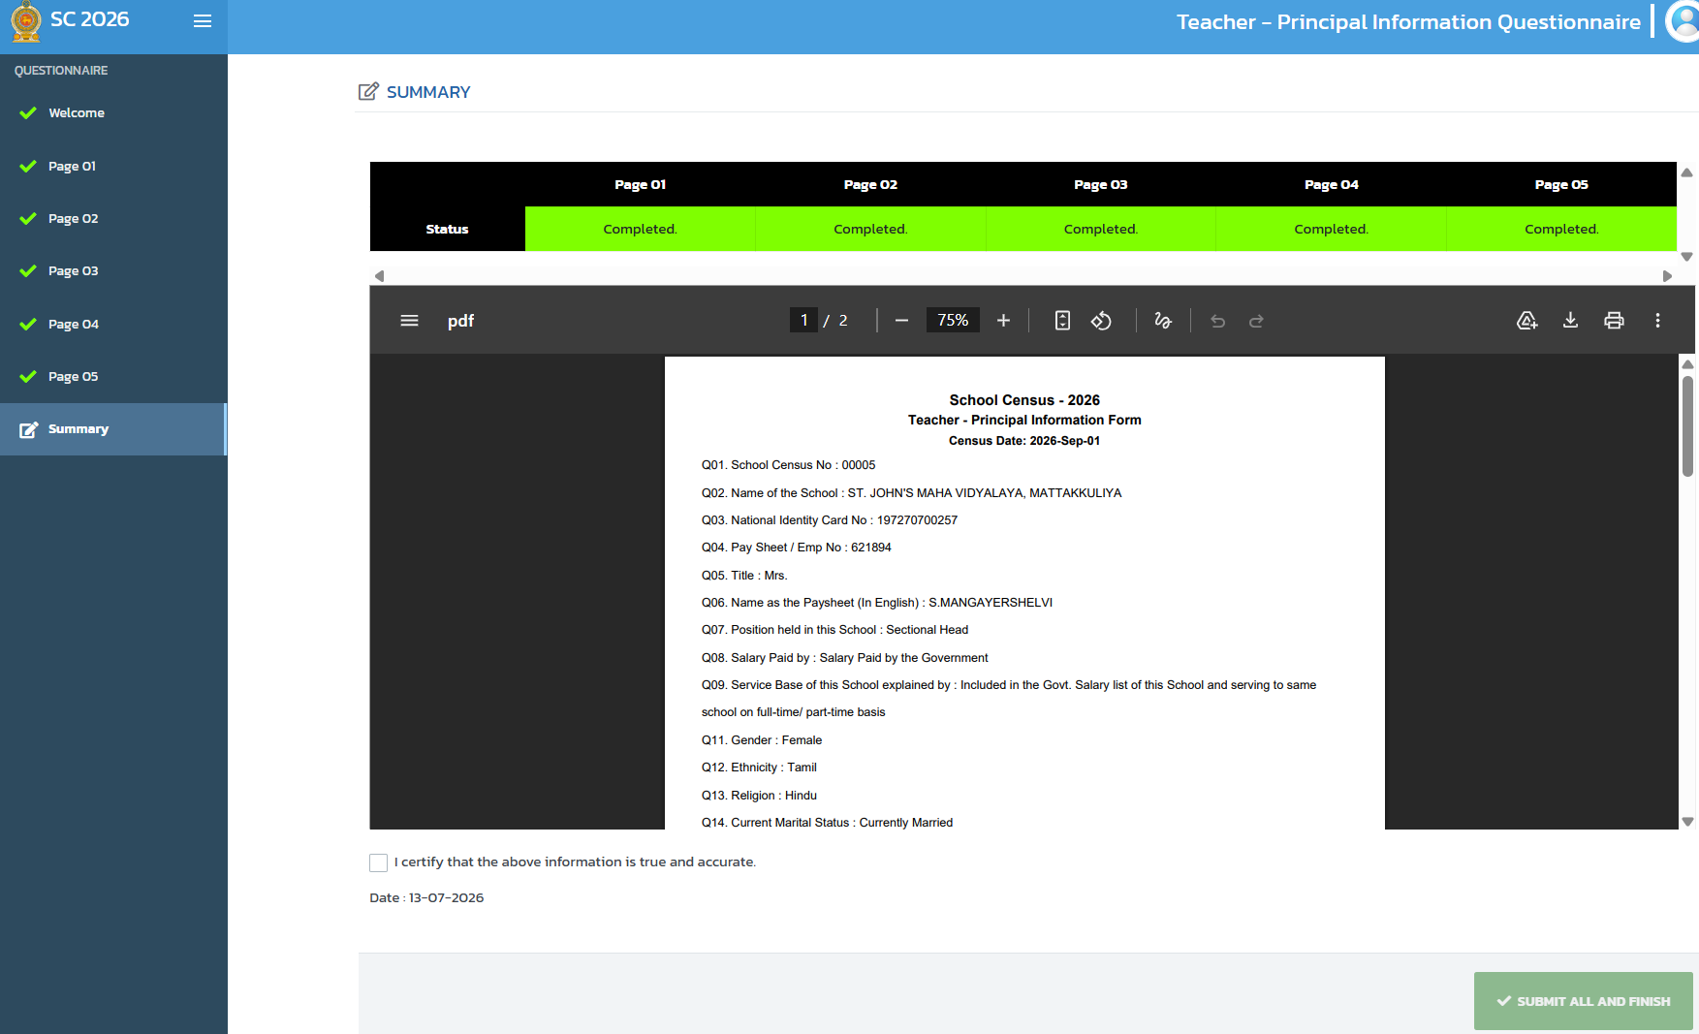
Appearance of the Summary Tab Section after Completion of the Updating the Data
Step 5: Go through the PDF and see all data updated are correct
Step 6: Download PDF document using Download Icon and Save in your own folder
Step 7: Print Two copies of PDF document using Print Icon (One Submit to School Data Officer and Keep other one with you)

Slide 13
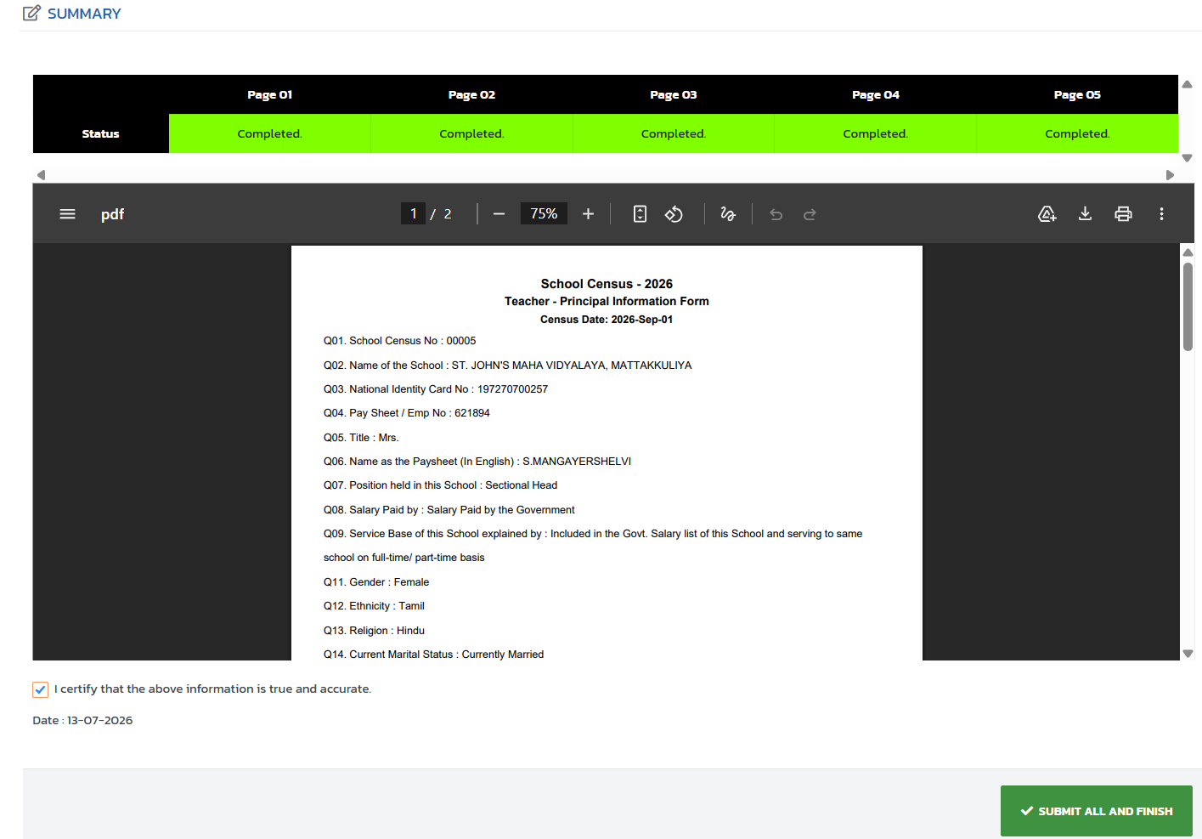
Step 8: Tick on “I certify that the above information is true and accurate” to confirm the correctness and accuracy of the information.
Step 9: Click on SUBMIT ALL AND FINISH button to complete the task.

